Slide 1
Git Basic
The Tran Oct 2013

Slide 2
Objectives
Understand of GIT (Basic commands, GIT Workflow…)
“You don’t know GIT, but now you can use it”. Feel comfortable to work with GIT.
Process and Branch Model

Slide 3
The past: CVS and SVN
Centralized Version Control Systems
Key concepts:
Users check code into central server
Require connection to the server to perform commits, create branch, merge, view commit history,…

Slide 4
What is Git?
Distributed Version Control System
Created by Linus Torvald in 2005
You can commit, create branch, merge, view commit history locally (nearly every operation is local)
Notes:
For example, to browse the history of the project, Git doesn’t need to go out to the server to
get the history and display it for you—it simply reads it directly from your local database.
If you want to see the changes introduced between the current version of a file and the file a month ago, Git can look up the file from
a month ago and do a local difference calculation, instead of having to either ask a remote server
to do it or pull an older version of the file from the remote server to do it locally.

Slide 5
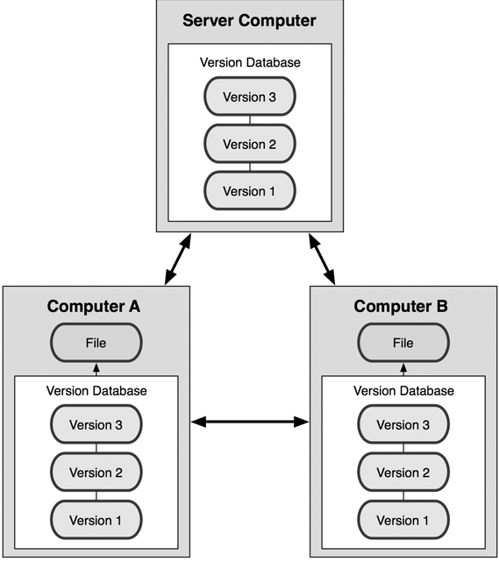
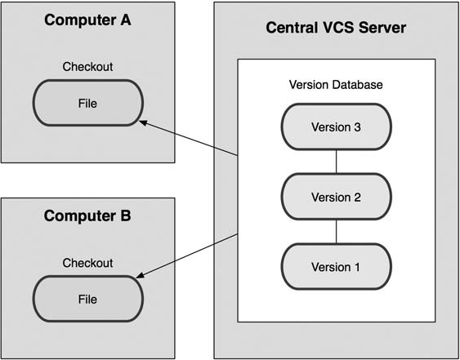
GIT vs SVN
Git: Distributed repository
SVN: Centralized repository

Slide 6
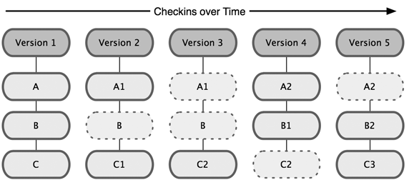
Git Basic: Snapshot
Git thinks of its data more like a set of snapshots of a mini file system
Every time you commit, Git create a snapshot for changes in project

Slide 7
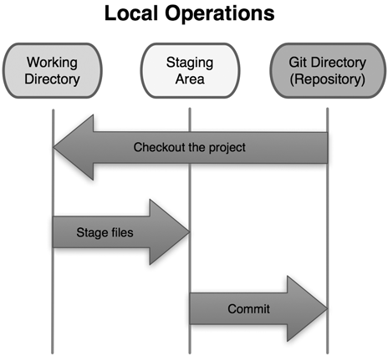
Git Basic: 3 States
Modified, staged and committed
Notes:
Git has three main states that your files can reside in: committed, modified, and staged.
Committed means that the data is safely stored in your local database.
Modified means that you have changed the file but have not committed it to your database yet.
Staged means that you have marked a modified file in its current version to go into your next commit snapshot.

Slide 8
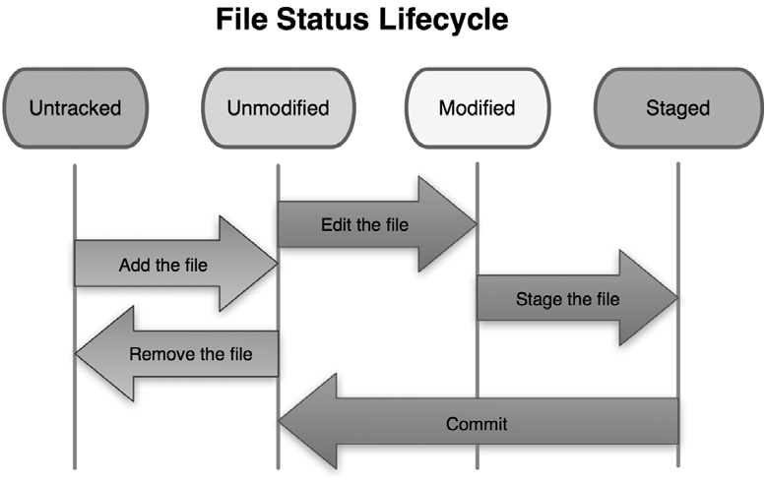
Git Basic: File Status Lifecycle
Notes:
Each file in your working directory can be in one of two states: tracked or untracked.
Tracked files are files that were in the last snapshot; they can be unmodified, modified, or staged.
Committed means that the data is safely stored in your local database.
Modified means that you have changed the file but have not committed it to your database yet.
Staged means that you have marked a modified file in its current version to go into your next commit snapshot.
Untracked files are everything else—any files in your working directory that weren’t in your last snapshot and aren’t in your staging area.
When you first clone a repository, all of your files will be tracked and unmodified because you just checked them out and haven’t edited anything.

Slide 9
Basic Workflow
unstaged
git add <files>
staged
local repo
remote repo
git commit
git push

Slide 10
Basic Usage
Clone code from remote repository (BitBucket, GitHub…)
$ git clone <repository-url>
Init at local only (need to add remote repository later)
$ git init

Slide 11
Basic Usage
Config info
git config --global user.name "Trung Le”
git config --global user.email "Trung.Le@tma.com.vn"
git config --global core.autocrlf false

Slide 12
Basic Usage
Checking the status of your files
$ git status
Tracking new file
$ git add <file>
Staging modified file
$ git add <file>

Slide 13
Basic Usage
View what you have changed
Staged files: git diff –-cached
Unstaged files: git diff
Commit your changes
git commit
git commit –m “your commit message here”

Slide 14
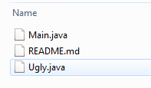

Basic Usage
RECOMMENDED
Remove files from Git repository
git rm Ugly.java
git rm –-cached Ugly.java

Slide 15
Basic Usage
View the commit history
$ git log
Compare code
$ git diff

Slide 16
Undo Things
Change your last commit message
$ git commit –-amend

Slide 17
Undo Things
Unstaging a staged file
You’ve changed two files and want to commit them as two separate changes, but you accidentally type git add * and stage them both.
$ git reset HEAD <file>

Slide 18
Undo Things
Revert to previous commit
$ git reset <commit id>

Slide 19
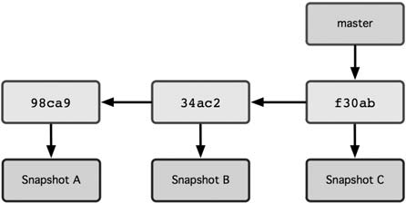
Working with Branches
Branch pointing into the commit data’s history

Slide 20
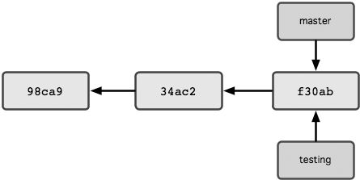
Working with Branches
Create branch testing from branch master:
$ git checkout master
$ git checkout –b testing

Slide 21
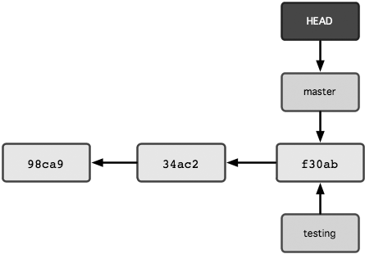
Working with Branches
How does Git know what branch you’re currently on?
HEAD pointer

Slide 22
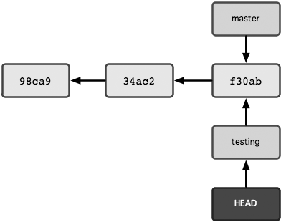
Working with Branches
Switch to branch testing
$ git checkout testing

Slide 23
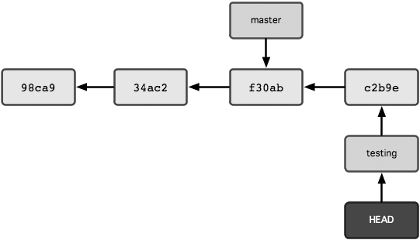
Working with Branches
Commit some changes on branch testing

Slide 24
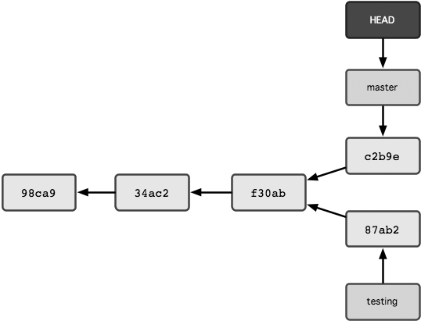
Working with Branches
Switch back to branch master, make some changes, and commit them

Slide 25
Working with Branches
What happened when switching to a branch?
Git changes the current branch to the branch you check out (remember HEAD pointer)
Git resets your working directory to look like the snapshot of the commit that the branch you check out points to
LEARN BY HEART!

Slide 26
Working with Branches
Before switching to other branch
Note that if your working directory or staging area has uncommitted changes that conflict with the branch you’re checking out, Git won’t let you switch branches.
It’s best to have a clean working state when you switch branches

Slide 27
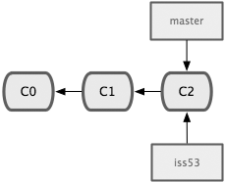
Branch Merging
Create new branch from branch master to work on new issue
$ git checkout master
$ git pull origin master
$ git checkout –b iss53

Slide 28
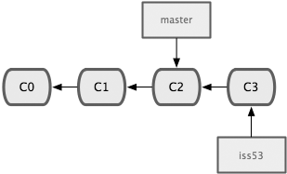
Branch Merging
Make some changes and do commit on branch iss53
$ vim index.html
$ git add index.html
$ git commit –m “iss53# added a new footer”

Slide 29
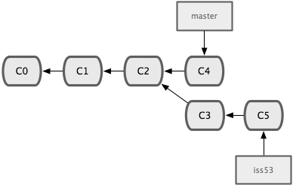
Branch Merging
Switch back to branch master, make some changes and do commit
Switch back to branch iss53, make some changes and do commit

Slide 30
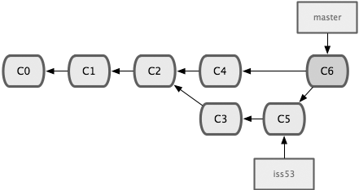
Branch Merging
Suppose you’ve decided that your issue #53 work is complete and ready to be merged into your master branch
$ git checkout master
$ git merge iss53
three-way merge
Common ancestor

Slide 31
Dealing with Merge Conflicts
You changed the same part of the same file differently in the two branches you’re merging together
View which files are unmerged
$ git status
Developers must resolve conflict using merge tools or text editor. Then use git add <file> to add these merged files to staging state.
If you use merge tool, Git may run git add automatically for you.
When all conflicts are resolved, you can run git commit to finalize the merge commit.

Slide 32
Merge Using BitBucket Pull Request
Use BitBucket Pull Request to merge branch iss53 into branch master

Slide 33
Merge Using BitBucket Pull Request
Push our local branch iss53 to BitBucket repository
$ git push –u origin iss53
=> Local branch iss53 set up to track remote branch iss53 from origin
Tip:
Using $ git remote –v to view your remotes
git@bitbucket.org:thetran/test.git

Slide 34
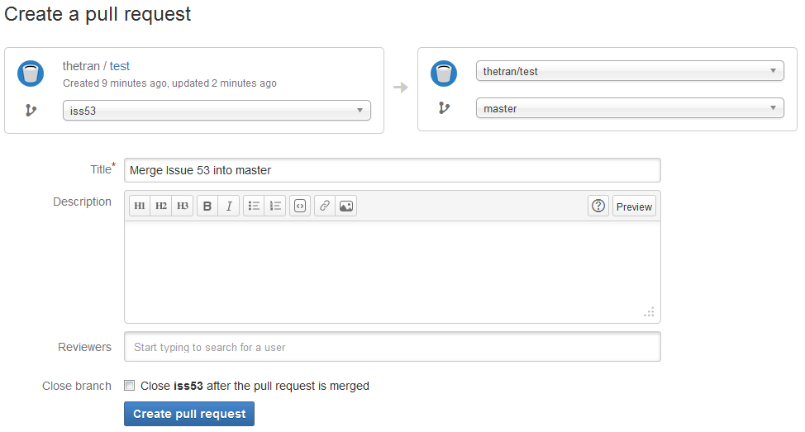
Merge Using BitBucket Pull Request

Slide 35
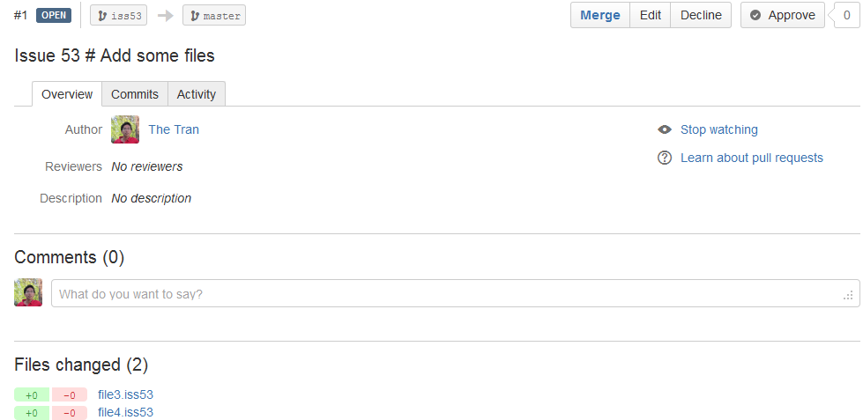
Merge Using BitBucket Pull Request

Slide 36
Working with Remotes
Show your remotes
$ git remote –v
Add remote repository
$ git remote add <repo_alias> remote_repo_url
Remove remote repository
$ git remote rm <repo_alias>
If you cloned a repository, the command automatically adds that remote repository under the name origin.

Slide 37
Working with Remotes
fetch and pull from your remote
$ git fetch origin : fetches any new work that has been pushed to that server since you cloned (or last fetched from) it
If you have a branch set up to track a remote branch, you can use the pull command to automatically fetch and then merge a remote branch into your current branch.

Slide 38
Working with Remotes
Push your local branch to the remote repository
$ git push –u origin iss53
Your local branch iss53 now track remote branch origin/iss53
Create local branch to track existing remote branch iss54
$ git fetch origin
$ git checkout –b iss54 origin/iss54
Push your work to remote repository
$ git checkout iss53
$ git pull origin iss53
$ git push origin iss53

Slide 39
Apply to GBST FO
$ git clone <repository-url>
Update your repository
$ git fetch origin
Get latest code from branch master
$ git checkout master
$ git pull origin master
Create your own local branch from master
$ git checkout –b iss55
Push your local branch to remote repository
$ git push –u origin iss55
Coding your feature, commit your work to your local repository
$ git commit
Push your work from local repository to remote repository
$ git pull origin iss55
$ git push origin iss55

Slide 40
Q & A

